Slide 1


Tutorial Mobilenet V2
2020.07.31
Hayeon Lee, Andreis Bruno

Slide 2
Environments
Prerequisites
● Ubuntu 16.04
● Python >= 3.5
● Tensorflow >= 1.8
pip package
● numpy >= 1.14
● opencv-python 4.1.0.25
● matplotlib 3.03
PPT & Code materials
● https://github.com/HayeonLee/0731_vision

Slide 3
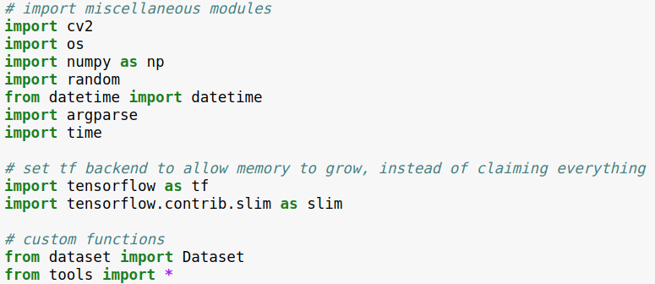
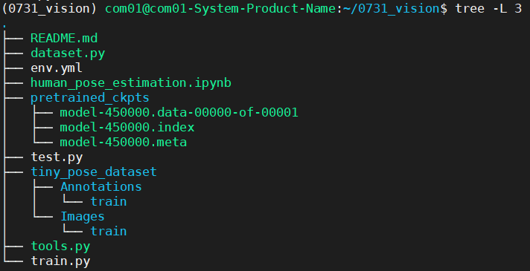
Human Pose Estimation using Mobilenet V2
Module Import
TF.Slim is effective to remove redundant code.
ex) slim.arg_scope, slim.stack

Slide 4
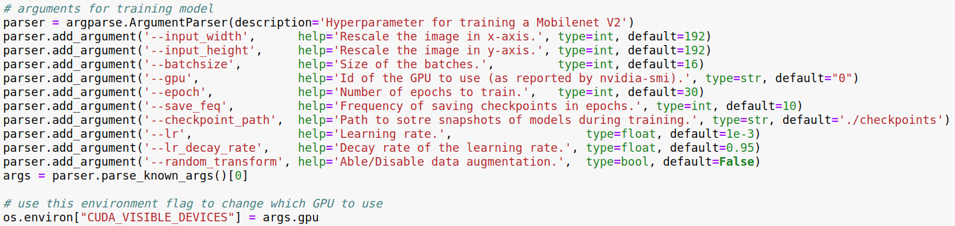
Human Pose Estimation using Mobilenet V2
Parsers – 10 arguments
- 10 optional arguments

Slide 5
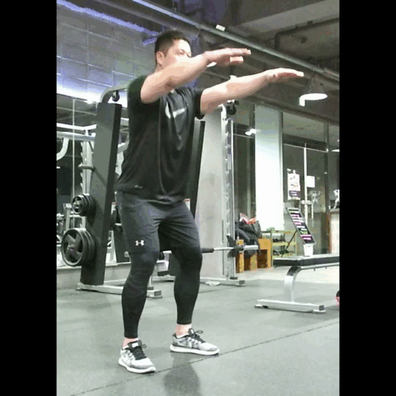
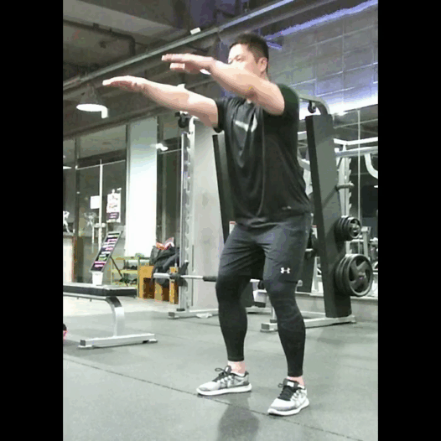
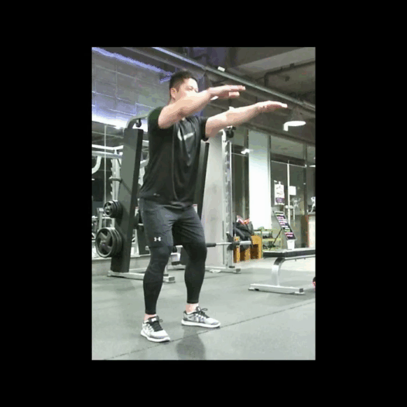
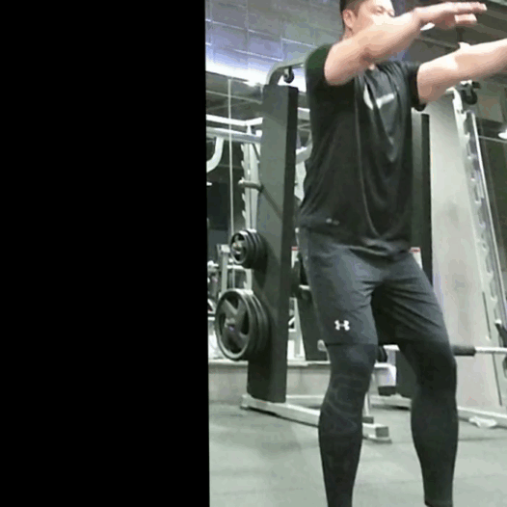
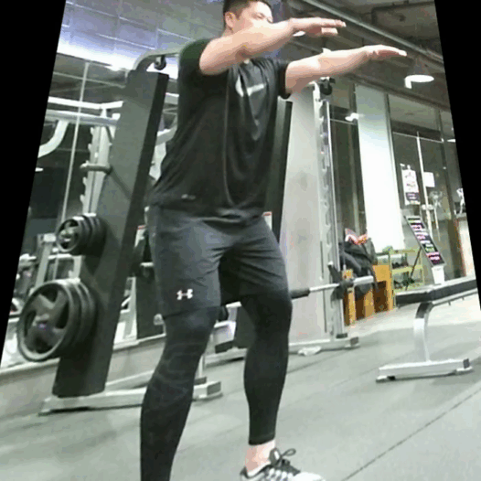
Human Pose Estimation using Mobilenet V2
Reproducibility
There is another way to prevent overfitting problem called data augmentation which is a strategy that enables practitioners to significantly increase the diversity of data.
True
Original
Flip
Scaling
Shift
Perspective Transform

Slide 6
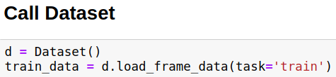
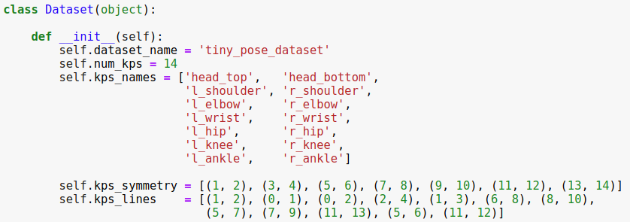
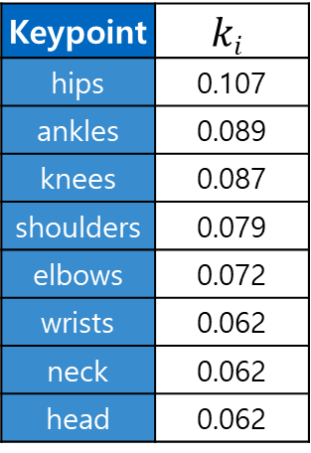
Human Pose Estimation using Mobilenet V2
Data Loading and Processing: Dataset
Keypoint | $$ki$$
hips | 0.107
ankles | 0.089
knees | 0.087
shoulders | 0.079
elbows | 0.072
wrists | 0.062
neck | 0.062
head | 0.062
Visualization of each keypoint and tolerance
14 types of keypoints.
Visibility flag annotations
357 images (train/val)

Slide 7
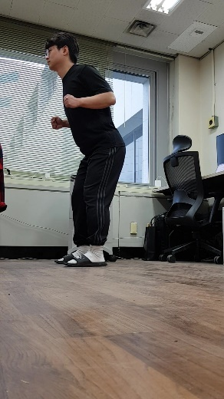
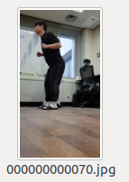
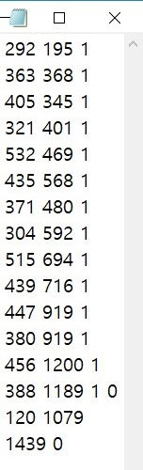
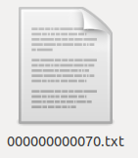
Human Pose Estimation using Mobilenet V2
Data Loading and Processing
Let’s see how to load data
RGB
14 keypoints
(x, y, flags)

Slide 8
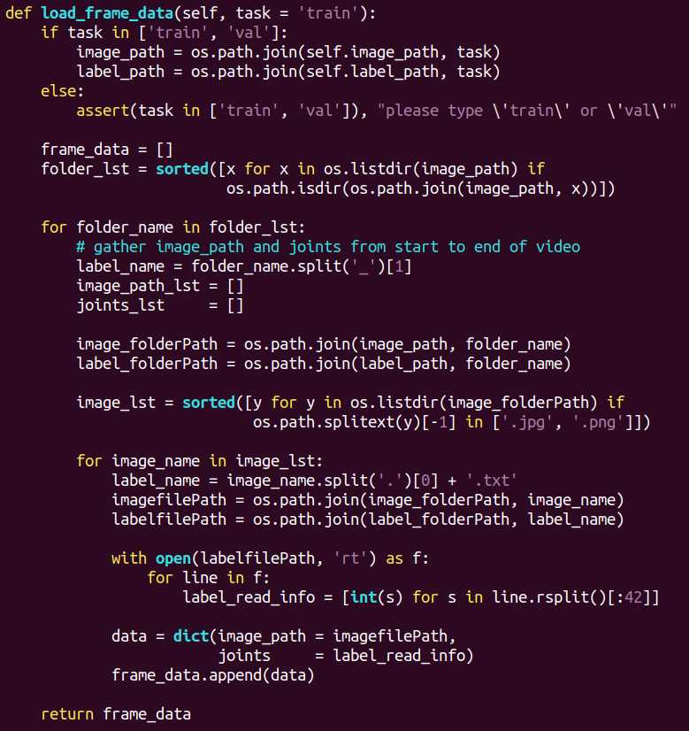
Human Pose Estimation using Mobilenet V2
Data Loading and Processing
Let’s see how to load data
RGB
14 keypoints
(x, y, flags)

Slide 9
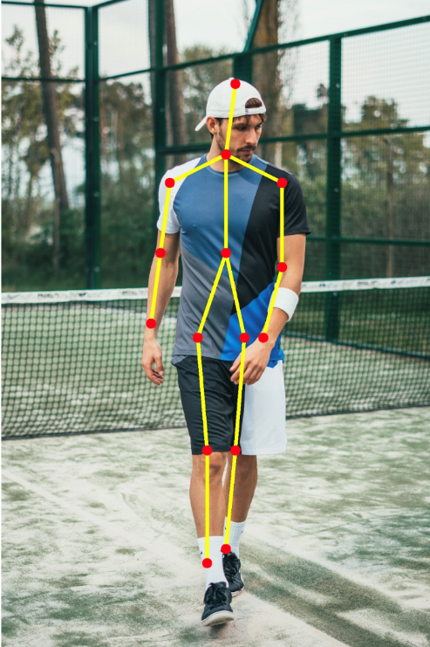
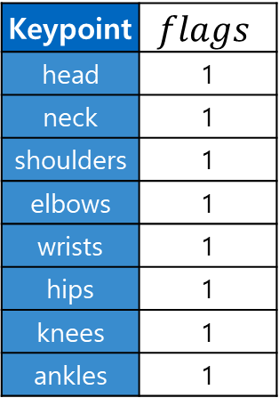
Human Pose Estimation using Mobilenet V2
Data Loading and Processing: Occlusion
Annotation info provide position of body parts and its visibility.
Keypoint | $$flags$$
head | 1
neck | 1
shoulders | 1
elbows | 1
wrists | 1
hips | 1
knees | 1
ankles | 1
14 keypoints
(x, y, flags)
All body part is visible.

Slide 10
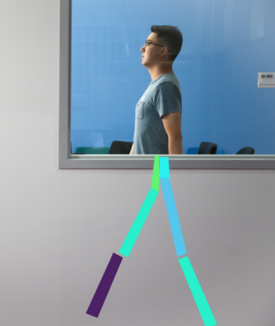
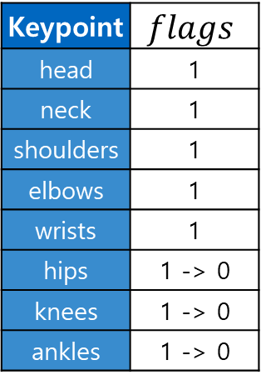
Human Pose Estimation using Mobilenet V2
Data Loading and Processing: Occlusion
Annotation info provide position of body parts and its visibility.
Keypoint | $$flags$$
head | 1
neck | 1
shoulders | 1
elbows | 1
wrists | 1
hips | 1 -> 0
knees | 1 -> 0
ankles | 1 -> 0
14 keypoints
(x, y, flags)
We don’t know what pose person is doing

Slide 11
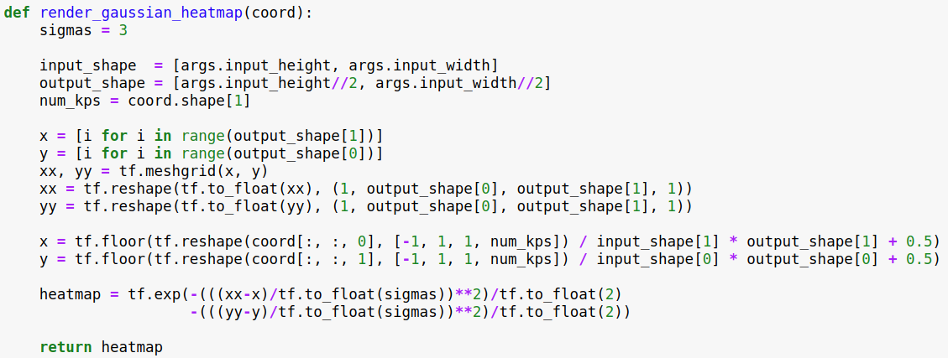
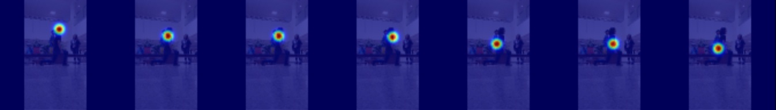
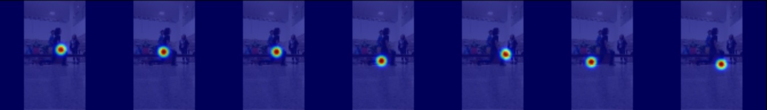
Human Pose Estimation using Mobilenet V2
Data Loading and Processing: Preprocessing (Gaussian Blur)
This function is used to generate the target heatmap for training using ground truth coordinate information
14 keypoints
head
neck
L-shoulder
R-shoulder
L-elbow
R-elbow
L-wrist
(x, y, flags)
R-wrist
L-hip
R-hip
L-knee
R-knee
L-ankle
R-ankle

Slide 12
Human Pose Estimation using Mobilenet V2
Data Loading and Processing: Preprocessing (Gaussian Blur)
This function is used to generate the target heatmap for training using ground truth coordinate information

Slide 13
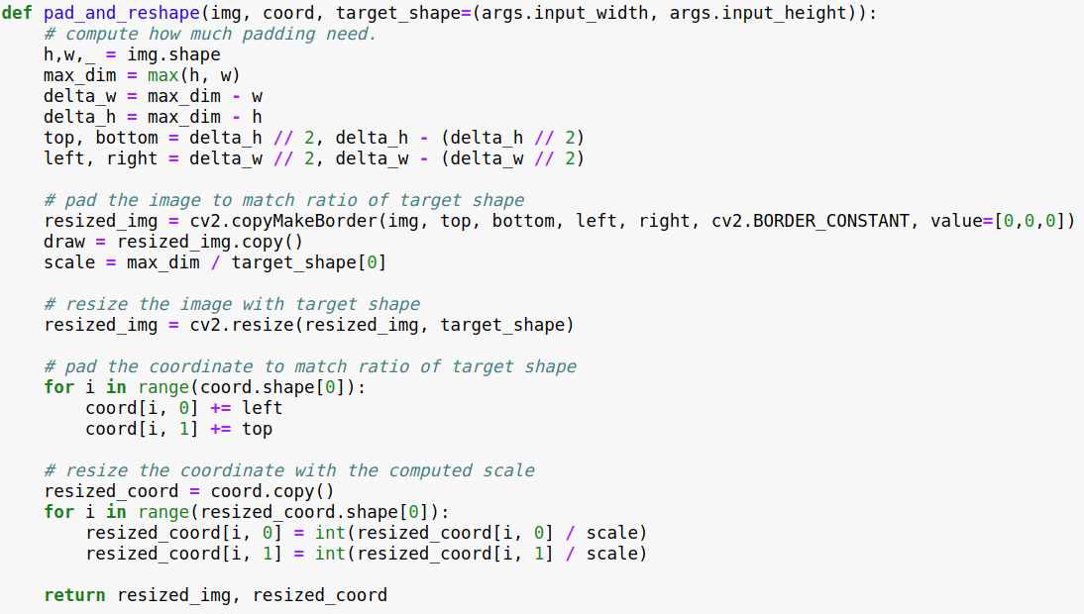
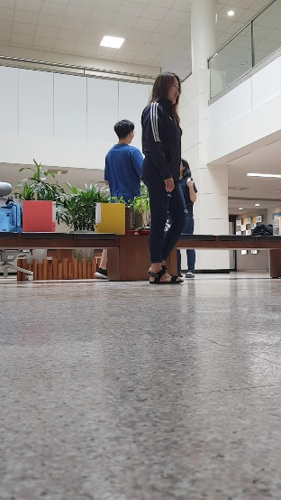
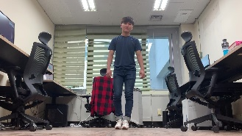
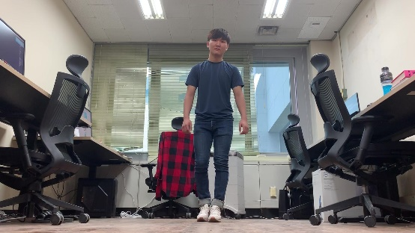

Human Pose Estimation using Mobilenet V2
Data Loading and Processing: Transforms
This function make all the inputs including image and coordinate to a specific target size.
padding
resize

Slide 14
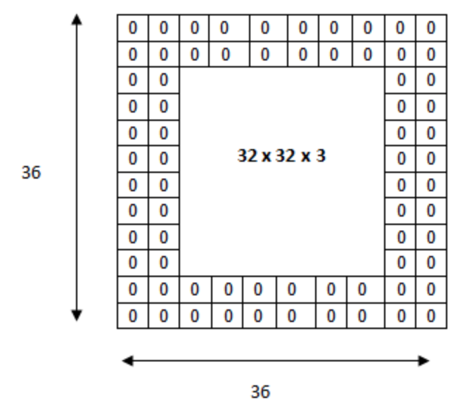
Human Pose Estimation using Mobilenet V2
Data Loading and Processing: Transforms
This function make all the inputs including image and coordinate to a specific target size.

Slide 15
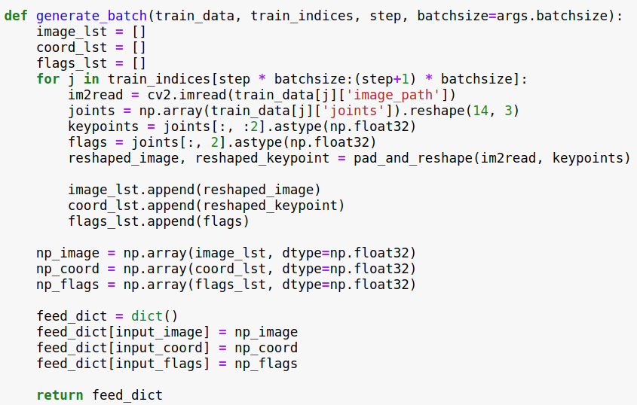


Human Pose Estimation using Mobilenet V2
Data Loading and Processing: DataLoader
This function create feed_dict for tensorflow session from training data matching image and coordinate information temporally.
. . .
. . .
Batch
Time
Image - Annotation

Slide 16
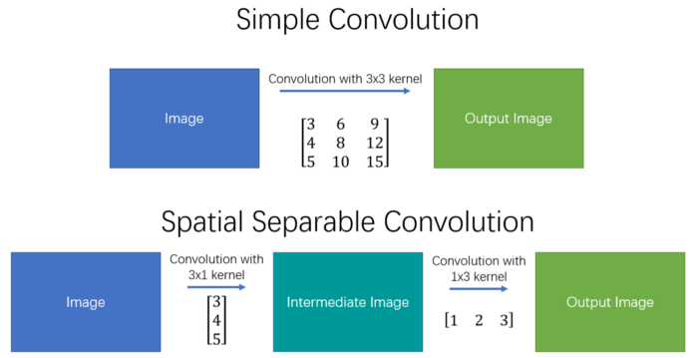
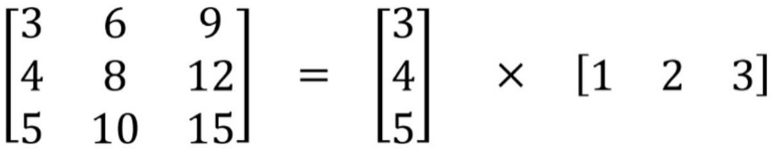
Separable Convolutions
The spatial separable convolution is so named because it deals primarily with the spatial dimensions of an image and kernel: the width and the height.
Separating a 3x3 kernel spatially
Computation Cost : 9 -> 6
Instead of doing one convolution with 9 multiplications, we do two convolutions with 3 multiplications each (6 in total) to achieve the same effect.

Slide 17
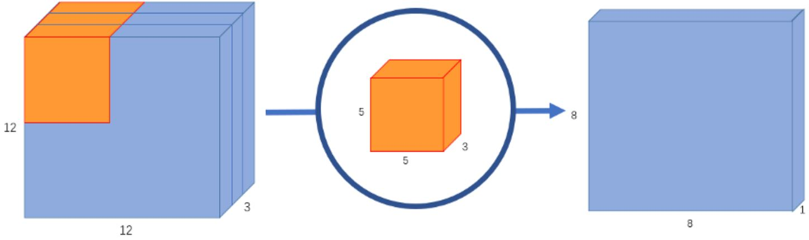
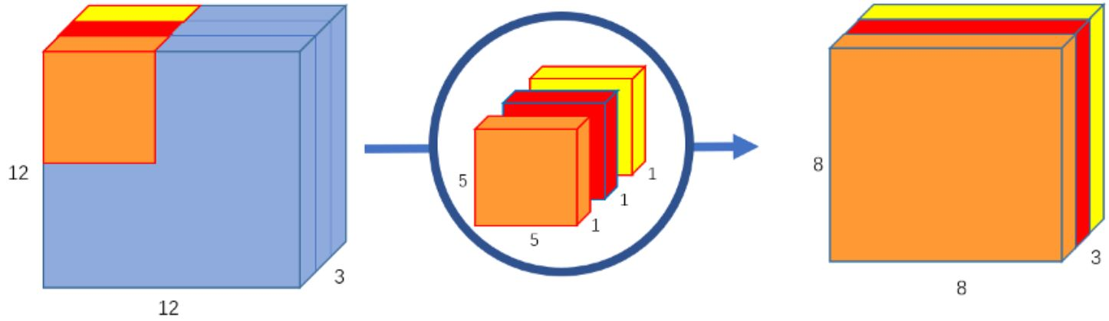
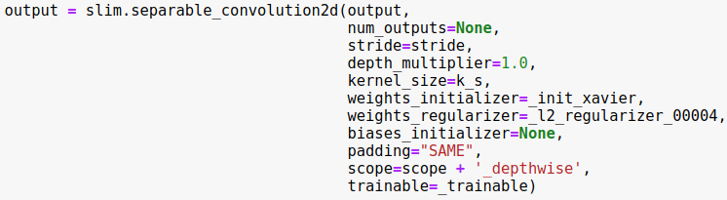
Depthwise Convolutions
The filter of depthwise convolution only perform spatial convolution, not channel-wise convolution operation.

Slide 18
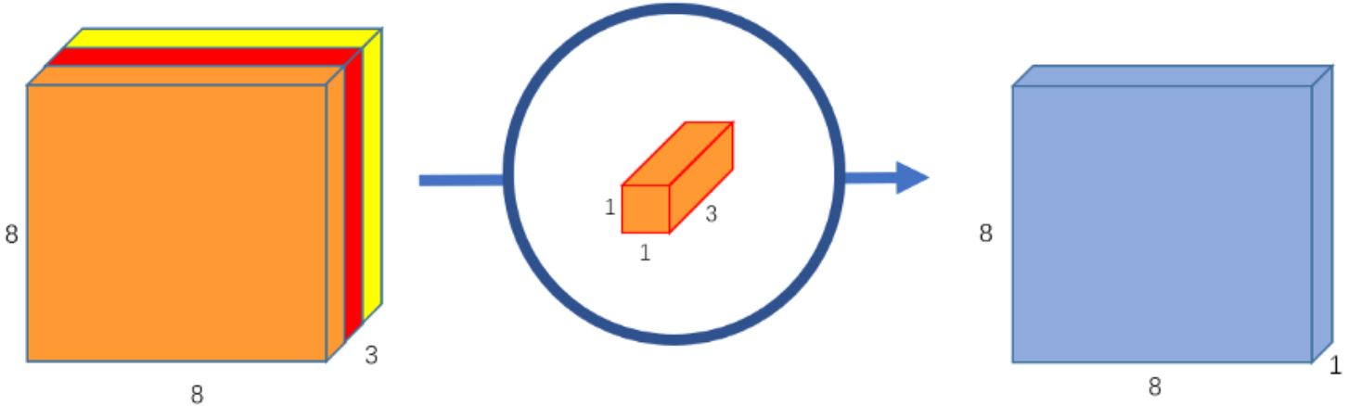
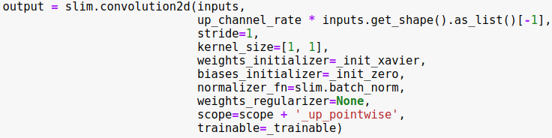
Pointwise Convolutions
The pointwise convolution is so named because it uses a 1x1 kernel, or a kernel that iterates through every single point.

Slide 19
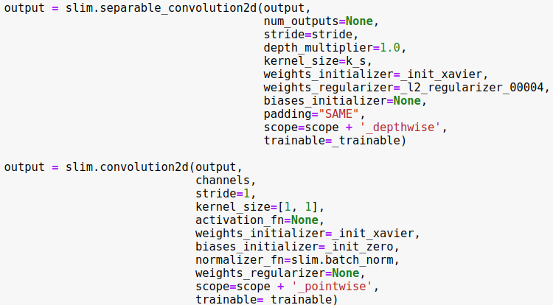
Depthwise Separable Convolutions
The filter of depthwise convolution only perform spatial convolution, not channel-wise convolution operation.

Slide 20
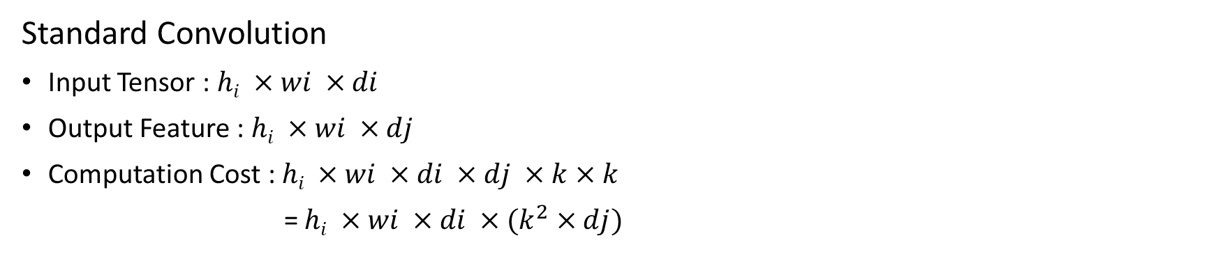
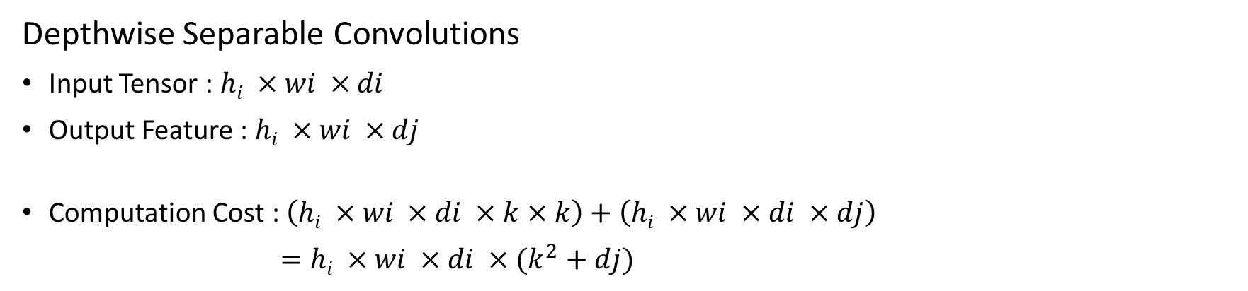
Depthwise Separable Convolutions
Standard Convolution
Input Tensor : $hi ×wi ×di$
Output Feature : $hi ×wi ×dj$
Computation Cost : $hi ×wi ×di ×dj ×k×k$
= $hi ×wi ×di ×(k^{2}×dj)$
Depthwise Separable Convolutions
Input Tensor : $hi ×wi ×di$
Output Feature : $hi ×wi ×dj$
Computation Cost : $\left(hi ×wi ×di ×k×k\right)+\left(hi ×wi ×di ×dj\right)$
$=hi ×wi ×di ×(k^{2}+dj)$

Slide 21
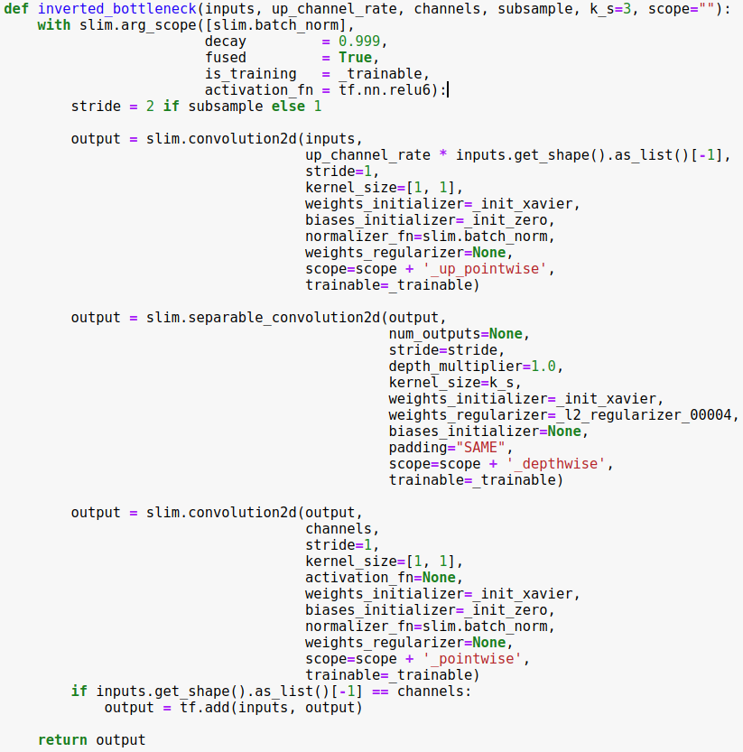
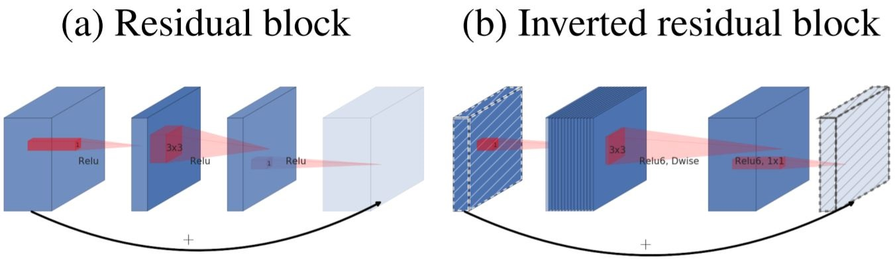
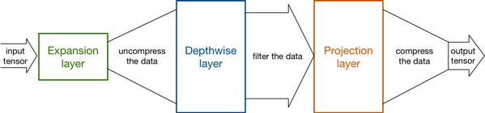
Inverted Residuals
Using low-dimensional tensors is the key to reducing the number of computations. The smaller tensor, the fewer multiplications the convolutional layers have to do.
Uncompress
Compress

Slide 22
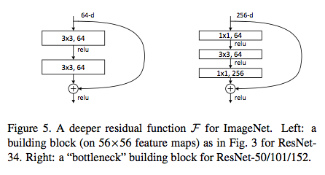
Linear Bottlenecks
We say that the set of layer activations (for any layer) forms a “manifold of interest”
This intuition breaks down when we recall that deep convolutional neural networks actually have non-linear per coordinate transformations, such as ReLU
Deep networks only have the power of a linear classifier on the non-zero volume part of the output domain.

Slide 23
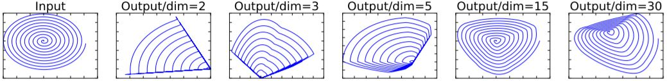
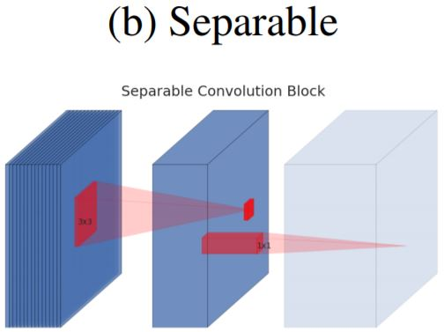
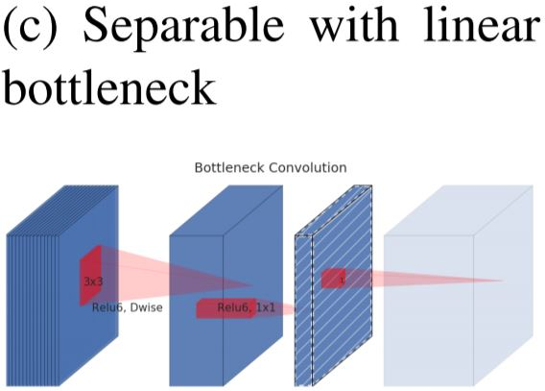
Inverted Linear Bottlenecks
With inverted residual blocks we do the opposite and squeeze the layers where the skip connections are linked. This hurts the performance of the network.
activation = relu6
Examples of ReLU transformations of low-dimensional manifolds embedded in higher-dimensional spaces
activation = relu6
activation = None
-> Linear

Slide 24
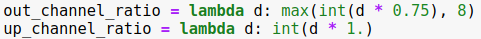
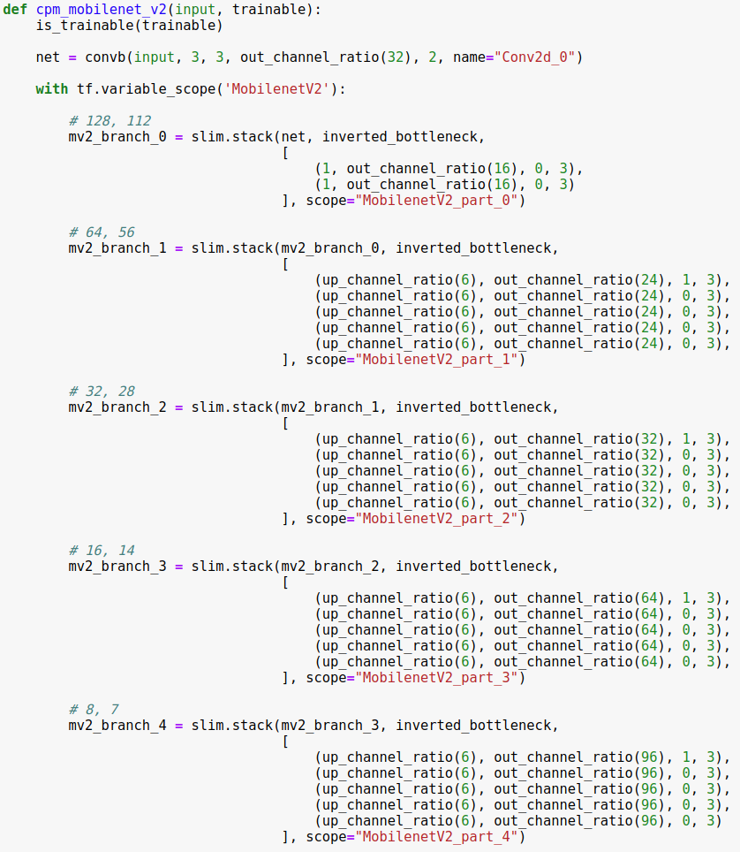
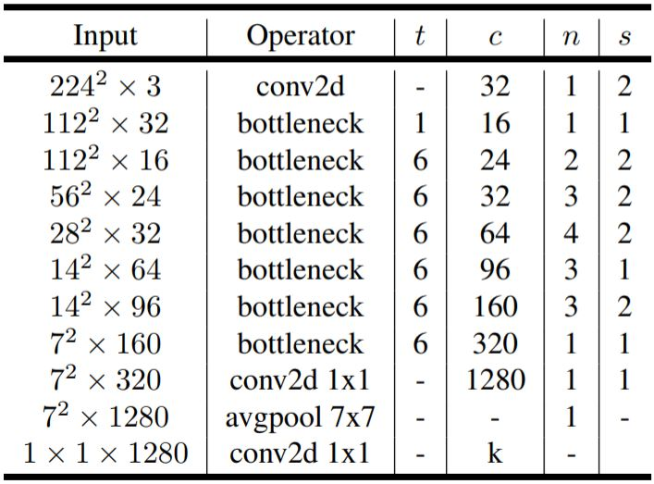
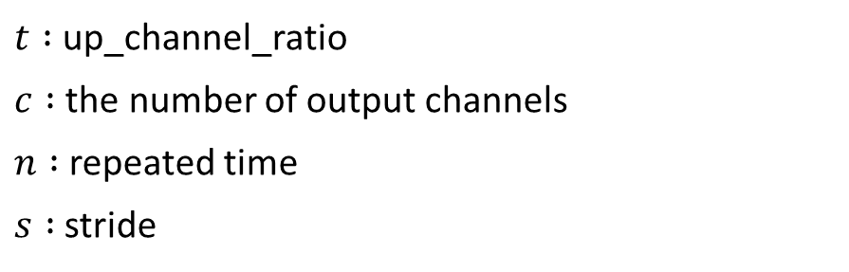
MobileNet V2
In this code, manipulate output channel per block to set final channel = 512.
$t :$ up_channel_ratio
$c :$ the number of output channels
$n :$ repeated time
$s :$ stride

Slide 25

MobileNet V2
In stem layer, perform normal conv2d because input form is low-dimensional.

Slide 26
MobileNet V2
In this code, manipulate output channel per block to set final channel = 512.

Slide 27
MobileNet V2
In this code, manipulate output channel per block to set final channel = 512.

Slide 28
MobileNet V2
In this code, manipulate output channel per block to set final channel = 512.

Slide 29
MobileNet V2
In this code, manipulate output channel per block to set final channel = 512.

Slide 30
MobileNet V2
In this code, manipulate output channel per block to set final channel = 512.

Slide 31

Convolutional Pose Machine(CPM)
Architecture and receptive fields of CPMs.

Slide 32
Convolutional Pose Machine(CPM)
Stage 1 – extract local body part feature.

Slide 33


Convolutional Pose Machine(CPM)
Stage 1 – extract local body part feature.

Slide 34

Convolutional Pose Machine(CPM)
Upsample function and max_pool function is used to concat the output of each branch with different dimensions.

Slide 35
Convolutional Pose Machine(CPM)
Stage 2 – Local feature + spatial context

Slide 36



Convolutional Pose Machine(CPM)
stage_number = 0

Slide 37

Convolutional Pose Machine(CPM)
stage_number = 1

Slide 38

Convolutional Pose Machine(CPM)
stage_number = 2

Slide 39

Convolutional Pose Machine(CPM)
stage_number = 2
local feature + body-part context

Slide 40





Minimum Square Error(MSE)
The loss function is defined as regression task using MSE of two heatmaps.
pred_heat (network output)
input_heatmaps (ground-truth)
head
neck
L-shoulder
R-shoulder
L-elbow
R-elbow
L-wrist
head
neck
L-shoulder
R-shoulder
L-elbow
R-elbow
L-wrist
R-wrist
L-hip
R-hip
L-knee
R-knee
L-ankle
R-ankle
R-wrist
L-hip
R-hip
L-knee
R-knee
L-ankle
R-ankle

Slide 41

Optimize Loss
Optimize loss to reduce MSE of Ground Truth heatmap and output heatmap.

Slide 42


Post Processing
pred_heat (network output)
head
neck
L-shoulder
R-shoulder
L-elbow
R-elbow
L-wrist
R-wrist
L-hip
R-hip
L-knee
R-knee
L-ankle
R-ankle
Keypoint Detection

